Slide 1
NBD1100 BUILT ENVIRONMENT COMMUNICATION AND SKILLS

Slide 2
Other scenarios of communication

Slide 3

Organising a meeting
What are the main objectives of meetings?
Please try to record how your discussion is going on

Slide 4
Group discussion
What do you need to do to organise an efficient and meaningful meeting?
Please try to record how your discussion is going on

Slide 5
Organising a meeting
to present and discuss ideas, identify and resolve problems, establish target dates and monitor progress.
Main objects of meetings include:
ensure that key personnel are fully informed;
obtain expert advice and opinion;
explore implications, enabling and encouraging everyone present to express their point of view about the issues under consideration;
receive and consider feedback from any relevant source;
attempt to resolve problems with a reasonable degree of collective agreement, recognising and recording disagreement or dissent;

Slide 6
Charing
A chair
An agenda
  Topics to be discussed
  The purpose of the meeting
  Possible outcomes/alternatives
Time limit
Objective and focused
Do not re-open discussions on agreed subject

Slide 7
Sensible decisions
Action for the future
An opportunity to raise other matters

Slide 8
Recording
An assigned person
Attendance
Listen and record
Headings
Categorise

Slide 9
How are you going to record a meeting minutes?
Format?
Key points?

Slide 10
Meeting minutes
Project title
Eg. New car-dealership at Old Mills Lane for (Client)
Meeting title
Eg. Minutes of site meeting No 4, Thursday 2nd March 2021, held on site
Present:
Eg.
Robert Green (RG) Client
David White (DW) Structural Engineer
Gavin Tunstall (GT) PGT Designers
Apologies for absence:
Eg. Received from Ron Blake (RB) Company Director who is looking for new opportunities in Uganda.

Slide 11
Include the previous minutes
The minutes can be recorded as the following
Eg. 1.0 Progress to Date:
1.1 The project is on course for completion as programmed for handover on 1 st May 2021. Foundations and ground beams are completed, 50% of the structural steel columns have been erected.
Details of the roller shutter doors have been issued to the contractor as requested, and the suppliers drawings for the steel cladding fixings for the roof have been received.
1.3 The revised delivery date for the remainder of the steel frame is now confirmed as 1 st April 2021.
2.0 Matters Arising from meeting No 3:
2.1 DW confirmed that the steel framework has now been approved by the Building Control Officer.
2.2 GT issued revised layout drawings for the staff toilets. R
2.3 G provided details of requirements for the external signs.
3.0 Any other business: …
4.0 Date and time of next meeting:
4.1Thursday 26 April 2021 in GT Design Office.

Slide 12
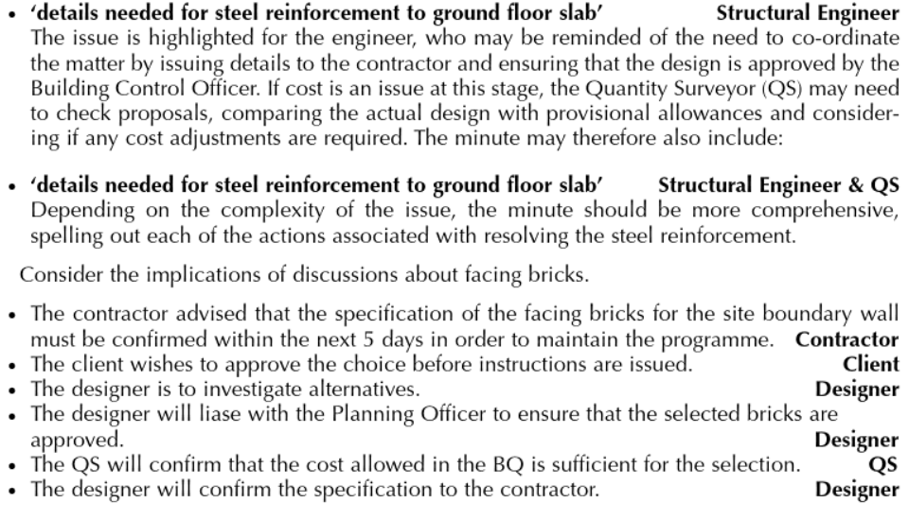
Actions:
Eg.

Slide 13
Actions:
Eg.

Slide 14
Actions:
Eg.

Slide 15
Please take a short break and come back at 3:25

Slide 16
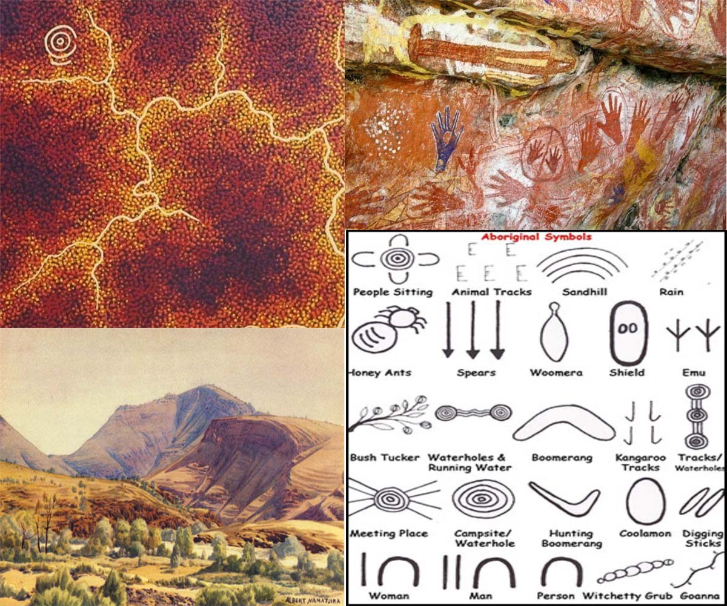
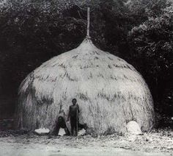
Class activity
You are invited to deliver a presentation to introduce Australian Aboriginal built environment and its related culture.

Slide 17
Class activity
You are invited to deliver a presentation to introduce Australian Aboriginal built environment and its related culture.
  Eg. a historical review
  Eg. shelter types
  Eg. the use of materials
  Eg. symbols
  Eg. admirable knowledge and ethical views
  Eg. new designs that relate to Aboriginal architecture

Slide 18
Class activity
You are invited to deliver a presentation to introduce Australian Aboriginal built environment and its related culture.

